Slide 1
Food for Thought
Data Slides

Slide 2
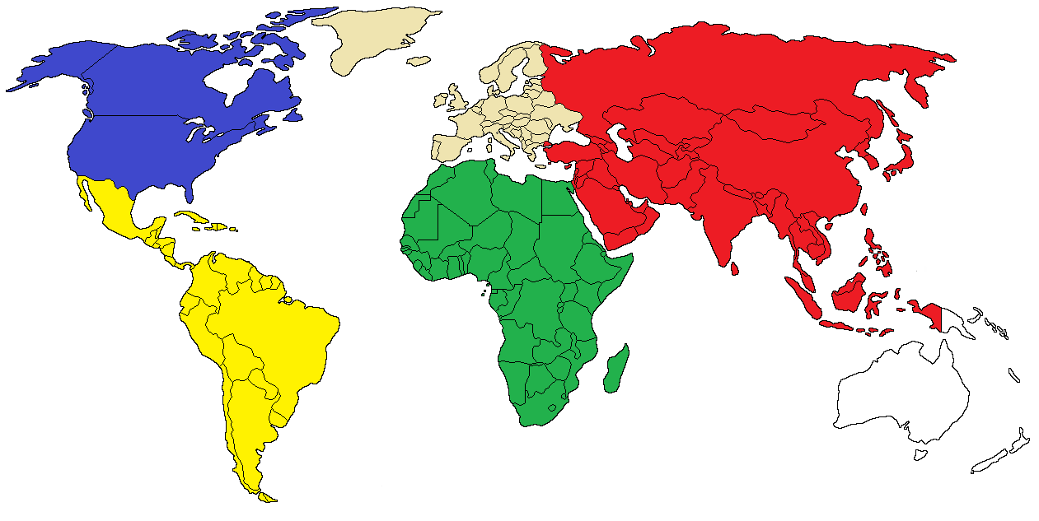

Slide 3
Population per Region (in millions)
Distribution for class of 25 students
North America = 362 (5%)
Europe = 745 (10%)
Asia = 4,494 (60%)
Latin America = 643 (9%)
Africa = 1,250 (17%)

Slide 4
Population Demographic Terms
Population: Number of people living in a region.
Birth Rate: Number of births per 1,000 people per year.
Death Rate: Number of deaths per 1,000 people per year.
Rate of Natural Increase: Growth caused by having more births than deaths in a year (does not include immigration or emigration).
Doubling Time: Number of years it will take a population to double in size if it maintains its current growth rate.

Slide 5
Population Demographics
Food for Thought
 | North America | Latin America | Europe | Africa | Asia
Population (in millions – 2018) | 362 | 643 | 745 | 1,250 | 4,494
Birth Rate (per 1,000) | 12 | 17 | 11 | 35 | 18
Death Rate (per 1,000) | 8 | 6 | 11 | 9 | 7
Growth Rate (natural increase) | 0.4 | 1.1 | 0 | 2.6 | 1.1
Doubling Time (in years) | 175 | 64 | - | 27 | 64

Slide 6
Quality of Life Terms
Literacy Rate: Ability of an individual to read and write, with understanding, a simple short statement related to his/her everyday life.
Total Fertility Rate: Average number of children a woman will have in her lifetime.
Infant Mortality Rate: Yearly number of children who die before reaching the age of one year per 1,000 live births.
Life Expectancy: Average number of years a person born today could expect to live.
Access to Improved Sanitation: Percentage of population with access to improved sanitation facilities that hygienically separate sewage from human contact.
Nurses and Midwives: Total number of people for every one nurse or midwife by region.

Slide 7
Quality of Life Indicators
Food for Thought
 | North America | Latin America | Europe | Africa | Asia
Adult Literacy Rate (men/women) | 97/96 | 93/92 | 99/99 | 72.56 | 89/80
Fertility Rate | 1.8 | 2.1 | 1.6 | 4.6 | 2.2
Infant Mortality Rate (per 1,000) | 6 | 17 | 5 | 51 | 28
Life Expectancy | 79 | 76 | 78 | 63 | 73
Access to Adequate Sanitation (urban/rural) | 100/100 | 88/64 | 95/89 | 44/25 | 81/51
1 Midwife or Nurse per # of People | 90 | 279 | 120 | 803 | 495

Slide 8
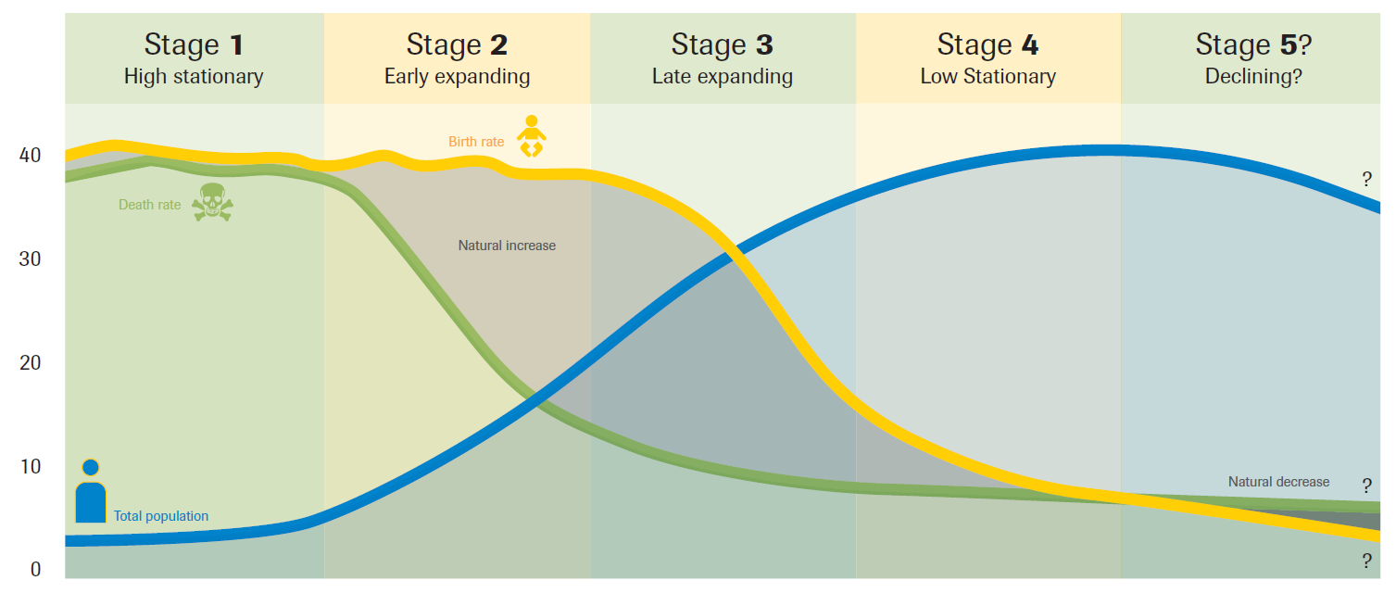
Demographic Transition Model

Slide 9
Land Use Terms
Urban Population: Percentage of the total population living in areas termed urban by that country (typically towns of 2,000 or more or in national or provincial capitals).
Arable Land: Farmland; land capable of growing crops. Here it is expressed in terms of acres of land per person. An acre is about the size of a U.S. football field.

Slide 10
Land Use Patterns
Food for Thought
 | North America | Latin America | Europe | Africa | Asia
Urban Population | 82% | 80% | 74% | 40% | 48%
Arable Land (acres/person) | 1.4 | 0.7 | 0.9 | 0.5 | 0.3

Slide 11
Arable Land (hectares/person) & Urban to Rural Ratio
North America
Europe
Asia
18%
Rural
26%
Rural
52%
Rural
48%
Urban
82%
Urban
74%
Urban
1.4 acres/person
0.9 acres/person
0.3 acres/person
Latin America
Africa
20%
Rural
40%
Urban
60%
Rural
80%
Urban
0.7 acres/person
0.5 acres/person

Slide 12
Energy Consumption and Wealth Terms
Energy Consumption: Total amount of energy used by each region per year divided by the number of people living in that region (includes industrial use). Access to electricity refers to the percentage of the population who have electricity in their homes.
Gross National Income (GNI): : A measure of a nation’s wealth, GNI is the total domestic and foreign output claimed by residents of a country. Here it is expressed per capita (dividing the total GNI by the region’s population) and Purchasing Power Parity (PPP) taking into account the different price levels and costs of living.

Slide 13
Energy Use and Wealth
Food for Thought
 | North America | Latin America | Europe | Africa | Asia
Per Capita Energy Consumption (barrels of oil equivalent)/% Access to Electricity | 55/100 | 10/96 | 27/100 | 3/45 | 10/89
Per Capita GNI (PPP) in USD | $56,554 | $15,001 | $33,677 | $4,833 | $12,833

Slide 14
Per Capita Energy Consumption
(barrels of oil equivalent)
North America
1 match = 1 barrel of oil
Asia
Europe
10 bbl/person
55 bbl/person
Africa
Latin America
27 bbl/person
3 bbl/person
10 bbl/person

Slide 15
Per Capita GNI
1 candy = $1,000 USD
North America
Europe
Latin America
Asia
Africa
$4,833
5 candies
$15,001
15 candies
$12,833
13 candies
$33,667
34 candies
$56,554
57 candies

